Slide 1





Langham Place
China Social Media Report
July 2026

Slide 2
Agenda
July Summary
  Followers Analysis
  Content Analysis
  Competitor Insights
  KOL Campaign Analysis
Learnings & Suggestions

Slide 3


July Performance Summary
Driven by the Sanrio and Chiikawa IP campaigns, all channels recorded notable fan growth and engagement in July.
XHS continued to lead in engagement rate and recorded the highest net fan growth among all channels.
WeChat recorded its highest fan net growth since the beginning of the year, while Channel maintained steady fan growth and total views, and Douyin reached its highest fan growth and total engagement since January.
A total of 4,935 RMB was spent on ad boosting, primarily on XHS to maximize reach for IP campaign posts and drive engagement.
Total Performance
Paid Performance
KPI Achievement
July 2026
Fans Number | 22,885 | 41,554 | 529 | 2,653
Fans Net growth | 782 | 316 | 13 | 385
No. of Post | 6 | 2 | 5 | 5
Total Views | 39,177 | 1,138 | 11,113 | 39,083
Total Engagement | 5,164 | 43 | 57 | 2,219
Engagement Rate | 13.18% | 3.78% | 0.51% | 5.68%
Channel | Cost | Total Impressions | Total Engagement
 | ¥2,975.01 | 33,983 | 1,965
 | ¥250 | 14,791 | 17
 | ¥1,710 | 41,259 | 2.217
Total | ¥4,935.01 | 90,033 | 4,199
XHS
77.83%
87.87%
86.20%
Fans Growth (4,670/ 6,000)
Engagement Rate (13.18% / 15%)
Fans Community (431 / 500)
WeChat
53.65%
91.04%
Total Views: 8,048/15,000
Monthly Views: 1,138/1,250
Channel
222.26%
99.49%
Monthly Views: 11,113/5,000
Yearly Views: 59,686/60,000
Douyin
58.07%
651.38%
Fans growth: 871/1,500
Monthly Views: 39,083/6,000
KOL Campaign
45.25%
184.86%
Total Views: 814,453/1800,000
Avg Engagment: 7,764/4,200

Slide 4
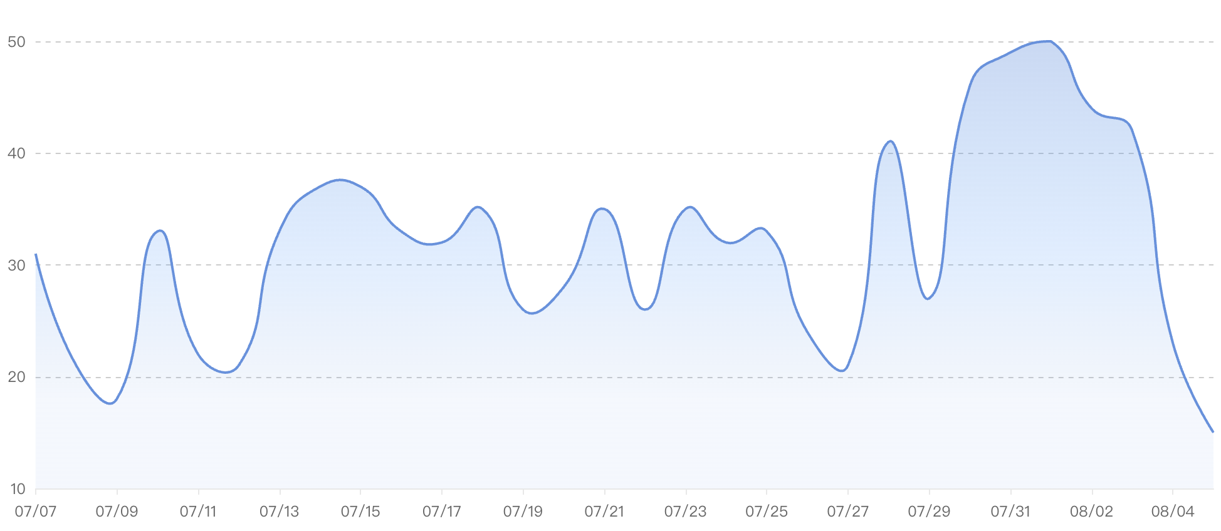
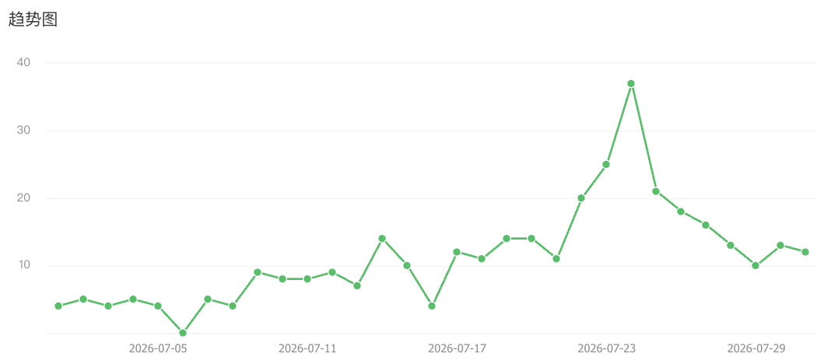

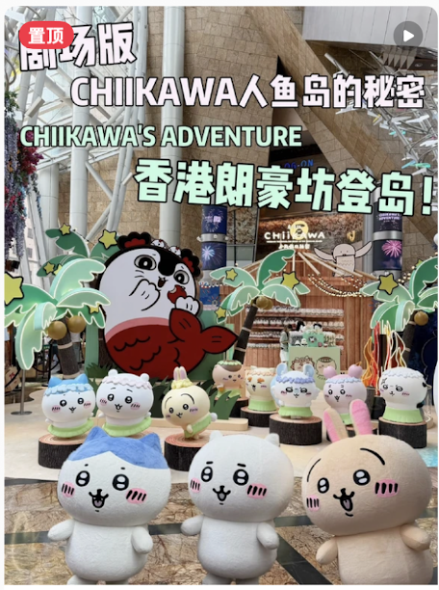
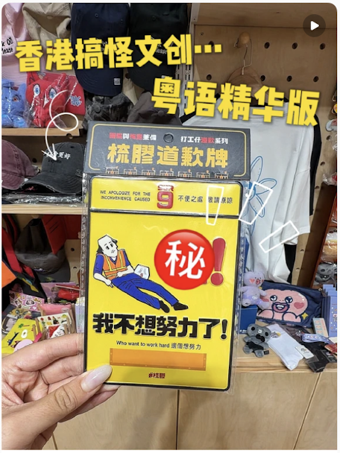
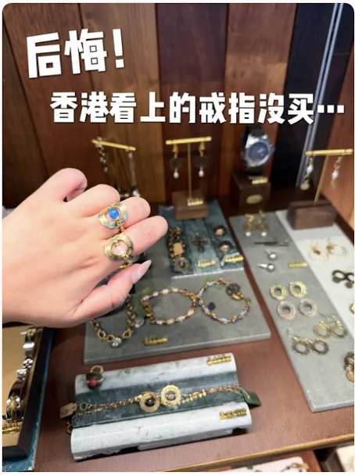
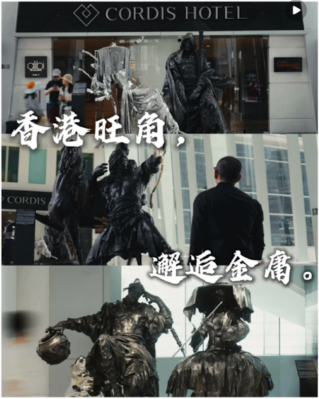
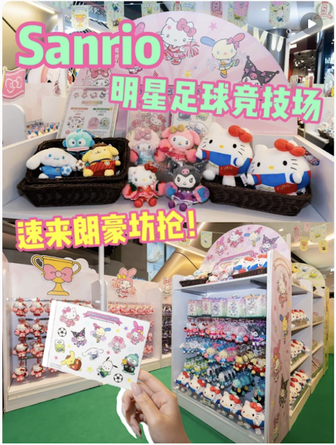
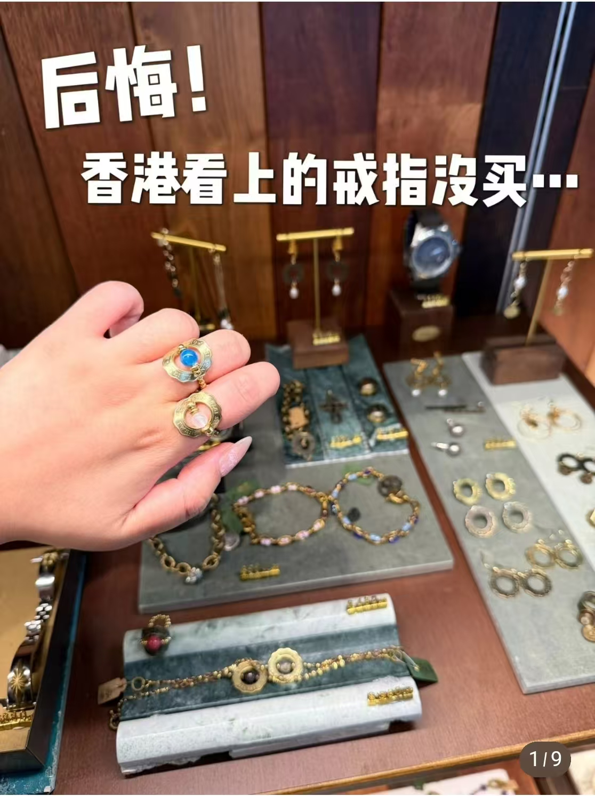

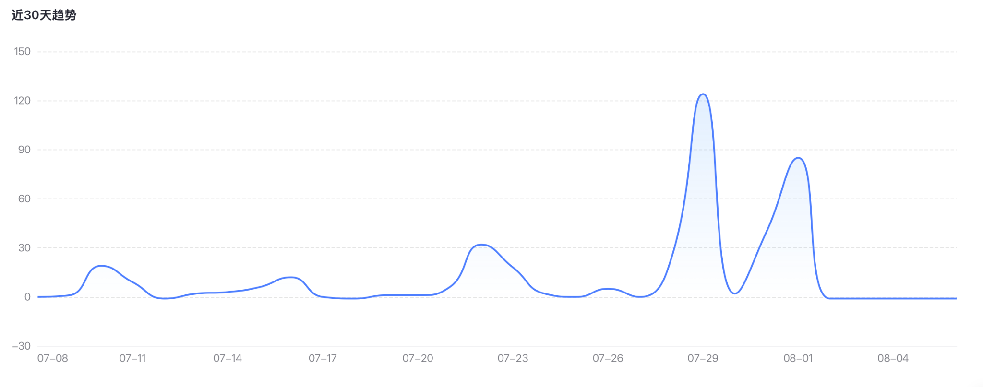
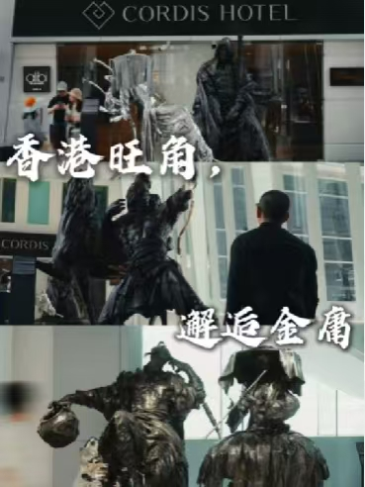
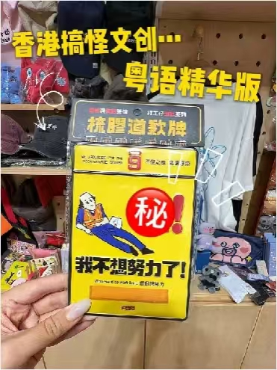

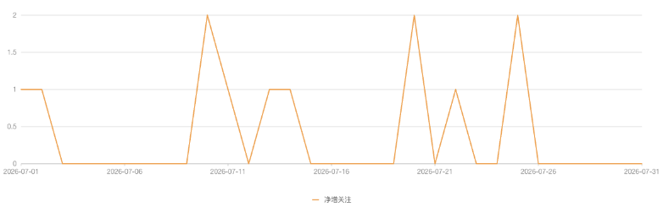
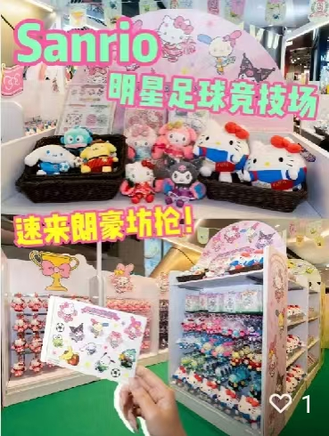
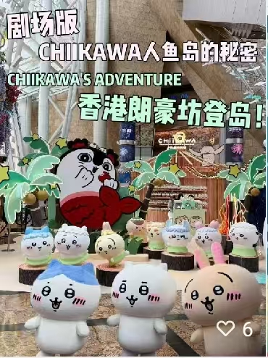
Fans Acquisition - Daily
In July, XHS's fan growth was driven by the Sanrio and Chiikawa IP campaigns, with multiple spikes recorded in mid and late July, attributed to IP campaign, 飾品店 种草post, and 金庸武俠世界 video, contributing to significant overall growth for the month.
WeChat (+316) and Douyin (+385) both recorded their highest fan growth in six months. Douyin's growth was fueled by IP campaigns, local lifestyle and cultural content, supported by ad strategy that combines engagement optimization with followers.
24 July
+ 37
7 July
+ 31
28 July
+ 41
31 July
+ 49
15 July
+ 37
21 July
+ 35
14 July
+ 14
29 July
+ 124
1 June
+ 3
20 July
+ 2
10 July
+ 2
9 June
+ 2
25 July
+ 2
6 June
+ 2
10 July
+ 19
22 July
+ 32
16 July
+ 12
22 June
+ 1
13 July
+ 1
15 June
+ 1
22 July
+ 1

Slide 5
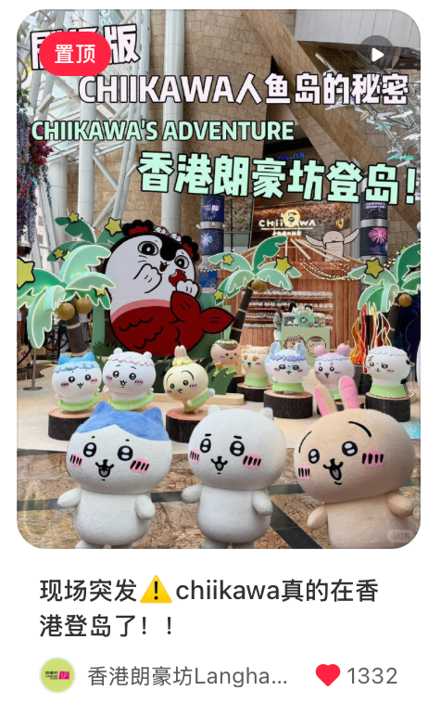
XHS Content Performance
In July, Chiikawa-related posts were the month's highlight. They recorded the highest total engagement and generated the highest views, while also driving the most fan growth, reflecting audience preference for real-time content that amplifies IP campaign momentum.
In terms of engagement rate, local cultural content "粵語文創" led at 28.70%, proving that Cantonese and local topics resonate deeply and drive meaningful interactions.
Other lifestyle and culture posts delivered steady performance.
XHS Post | Publish Date | Subject | View | Like | Comment | Saved | Share | Total Engagement | Total Engagement Rate | Fans Increased
1 | Jul 3 | 香港速冲🔥Sanrio新系列可爱爆炸⚽️ | 2,681 | 149 | 1 | 28 | 42 | 220 | 8.21% | 7
2 | Jul 6 | 确定了⚠️7月CHIIKAWA要在香港登岛啦！！ | 14,359 | 599 | 34 | 116 | 463 | 1,212 | 8.44% | 137
3 | Jul 10 | 现场突发⚠️chiikawa真的在香港登岛了！！ | 9,233 | 1,135 | 27 | 124 | 256 | 1,542 | 16.70% | 137
4 | Jul 16 | 香港粤语文创...我真的没空陪你闹了！😂 | 4,154 | 529 | 0 | 67 | 596 | 1,192 | 28.70% | 12
5 | Jul 21 | 后悔没买😭谁知道朗豪坊这家饰品叫什么？ | 5,472 | 167 | 11 | 106 | 284 | 568 | 10.38% | 29
6 | Jul30 | 『香港避暑』旺角邂逅金庸的武侠世界 | 3,278 | 184 | 1 | 30 | 215 | 430 | 13.12% | 28
Jul Total |  |  | 39,177 | 2,763 | 74 | 471 | 1,856 | 5,164 | 13.18% | 350

Slide 6
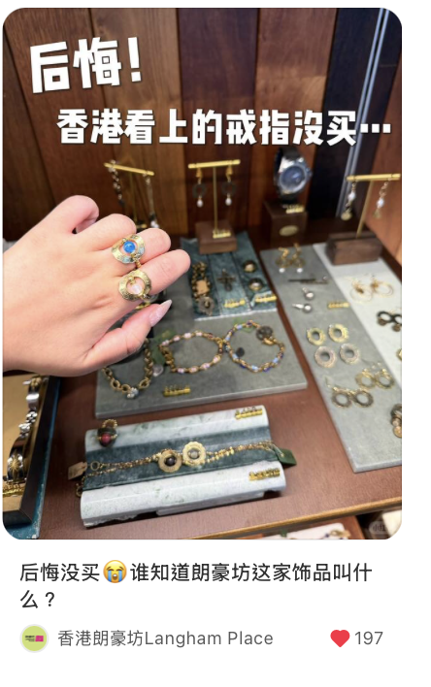
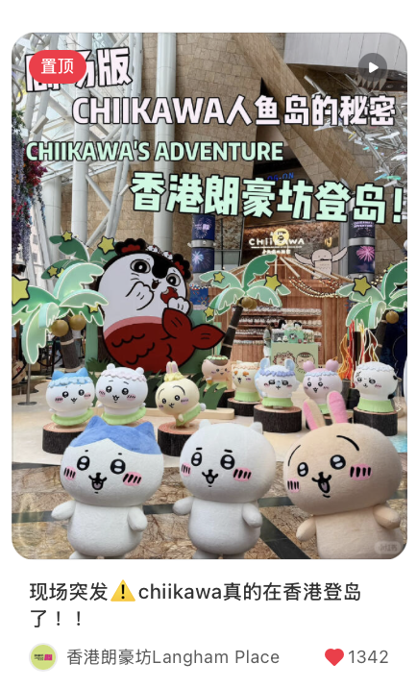
XHS Boosting performance
Metric | Jan | Feb | Mar | Apr | May | June | July | vs June | vs Q2 Avg | vs July 2025 | 2025 Avg
CPE ¥ | ¥1.98 | ¥2.67 | ¥0.83 | ¥0.94 | ¥2.79 | ¥1.31 | ¥1.51 | ↑15.26% | ¥1.68 （↓10.1%） | ¥2.68 （↓43.6%） | ¥2.67
CPM ¥ | ¥37.84 | ¥86.53 | ¥74.98 | ¥67.78 | ¥56.82 | ¥79.01 | ¥87.54 | ↑10.79% | ¥67.87 (↑28.9%) | ¥51.44 (↑70.17%) | ¥62.38
CTR | 13.49% | 8.43% | 11.03% | 11.29% | 10.84% | 10.12% | 10.01% | ↓1.08% | 10.75% (↓6.6%) | 9.67% (↑3.51%) | 8.62%
July XHS Boosting Performance:
CPE: Up 15.26% vs June, lower than the Q2 average and below the July 2025 benchmark, and 2025 average.
CPM: Up 10.79% vs June, sits above Q2 average, and above both July 2025 and 2025 average.
CTR: Down 1.08% vs June, slightly below Q2 average, yet higher than both July 2025 and 2025 average.
Category | XHS Subject | Period | Objectives | Cost￥ | Impressions | Clicks | Total Engagement | CTR | CPC ¥ | CPE ¥ | CPM ¥
聚光 | 宠粉福利选中了你🔔请领取美丽眼影胭脂盘 | 7/1 | 互动量 | ¥204.78 | 3,101 | 114 | 97 | 3.68% | ¥01.8 | ¥2.11 | ¥66.04
 | 确定了⚠️7月CHIIKAWA要在香港登岛啦 | 7/6 | 互动量 | ¥455.32 | 4,176 | 319 | 216 | 7.64% | ¥1.43 | ¥2.11 | ¥109.03
 | 现场突发⚠️chiikawa真的在香港登岛了 | 7/10 | 互动量 | ¥660.23 | 10,198 | 1,032 | 710 | 10.12% | ¥0.64 | ¥0.93 | ¥64.74
 | 香港粤语文创...我真的没空陪你闹了！😂 | 7/16 | 互动量 | ¥656.71 | 3,779 | 615 | 630 | 16.27% | ¥1.07 | ¥1.04 | ¥173.78
 | 后悔没买😭谁知道朗豪坊这家饰品叫什么？ | 7/21 | 互动量 | ¥480.79 | 7,574 | 919 | 141 | 12.13% | ¥0.53 | ¥3.41 | ¥63.48
 | 『香港避暑』旺角邂逅金庸的武侠世界 | 7/31 | 互动量 | ¥142.18 | 3,500 | 147 | 108 | 8.31% | ¥1.53 | ¥1.95 | ¥127.06
薯條 | 香港速冲🔥Sanrio新系列可爱爆炸⚽️ | 7/6 | 讚與收藏 | ¥375.00 | 3155 | 258 | 63 | 8.18% | ¥0.97 | ¥1.32 | ¥71.09
Jul Total |  |  |  | ¥2975.01 | 33,983 | 3,404 | 1,965 | 10.01% | ¥0.87 | ¥1.51 | ¥87.54
Exchange rate: 1HKD = 0.87RMB
Notes:
Total Cost: 3,414.66 HKD (3,006.90 RMB)
CPE: 3,414.66 / 3,196 = 1.07 HKD (0.94 RMB)
CPM: 3,414.66 / 44,431 x 1000 = 76.84 HKD (67.67 RMB)
CTR: 5,017 / 44,431 x 100 = 11.29%

Slide 7
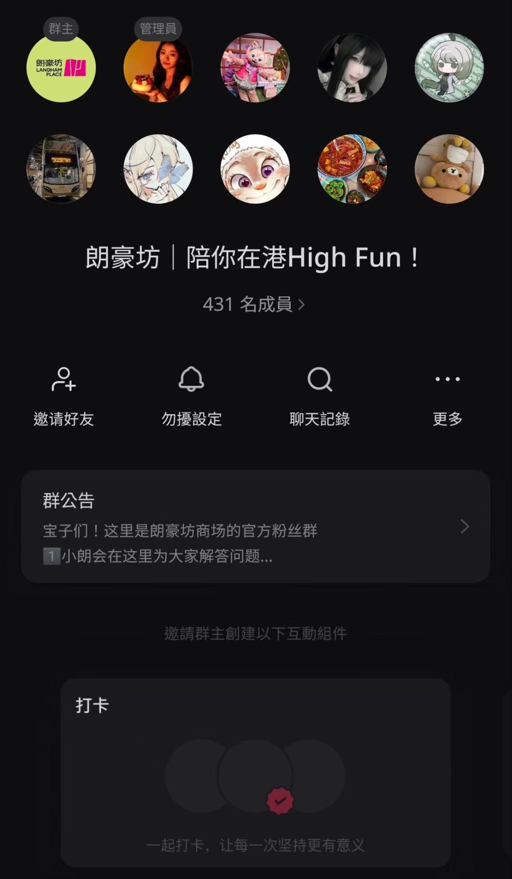
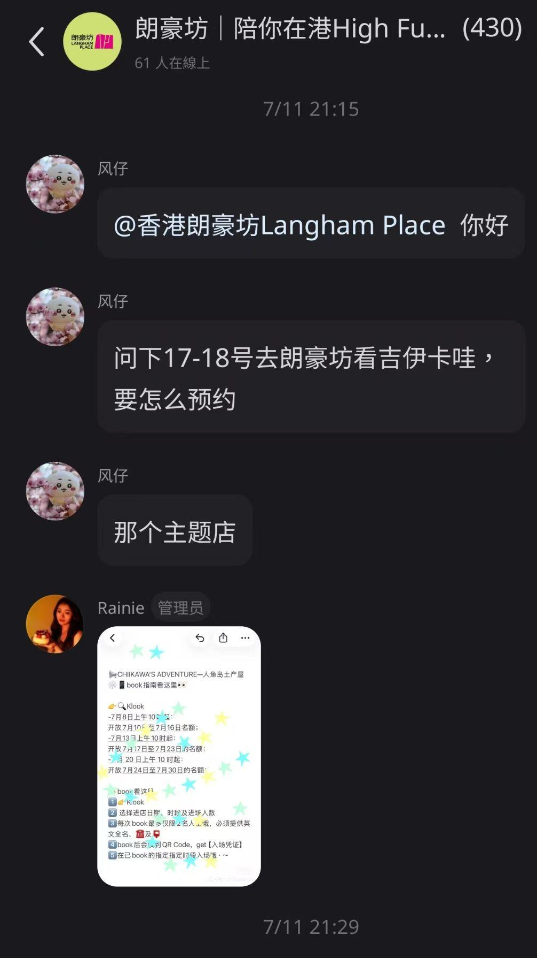
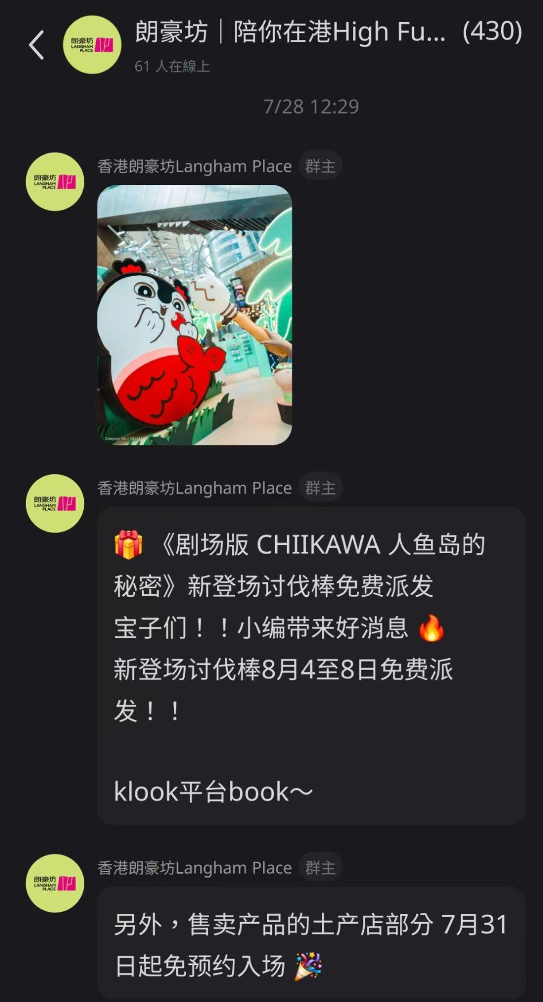
Fans Group Recap
Screenshot Highlights
Strengthen group-to-UGC conversion
Expand always-on
content variety
Community Snapshot
July: 431 members (on par with June)
IP Campaign announcement
Always-on updates launched
This Month's Key Actions
Real-time product inquiry support
01
Provided real-time responses to member inquiries, including pricing, recommendations, and discounts, turning the group into a responsive customer channel.
Note-to-group conversion
02
Maintained ongoing engagement with fans via the group, sharing campaign updates and exclusive news to sustain event buzz and keep the community actively connected.
Always-on content update
03
Continued sharing regular Langham Place updates, including new store launches, fashion, and campaign newss.

Slide 8
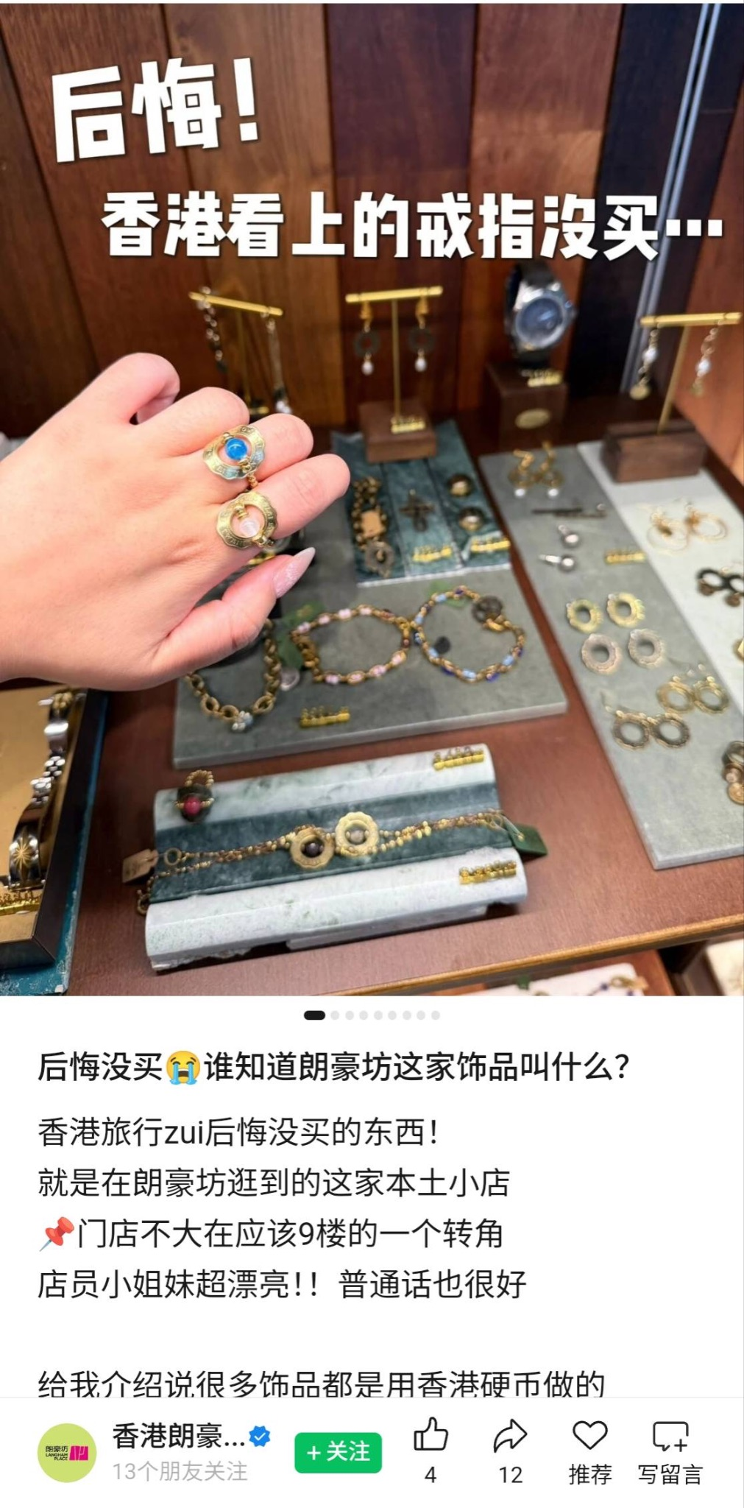

WeChat Performance Summary
We published 2 WeChat posts in July. The Sanrio IP post recorded a high engagement rate of 9.67% despite lower views (269), reflecting that IP content effectively drives deep interaction on WeChat. The accessory store post generated higher views but a lower engagement rate of 1.96%, indicating that while 种草 content has conversion power, it is less shareable and less viral than IP content.
Compared to June, both total views and engagement rate declined (engagement rate dropped from 9.16% to 3.78%), mainly due to fewer posts.
A Chiikawa long-form post was published in early August, and the hot IP effect is expected to boost views and engagement performance.
Wechat Post | Date | Subject | View | Mark | Comment | Like | Share | Total Engagement | Engagement Rate
1 | Jul 6 | Sanrio明星竞技场、潮流运动品牌一次逛到腿软！ | 269 | 3 | 0 | 9 | 14 | 26 | 9.67%
2 | Jul 21 | 后悔没买😭谁知道朗豪坊这家饰品叫什么？ | 869 | 0 | 0 | 4 | 12 | 17 | 1.96%
Jul Total |  |  | 1,138 | 3 | 1 | 13 | 26 | 43 | 3.78%
*ENGAGEMENT = MARK + COMMENTS + LIKES + SHARES

Slide 9
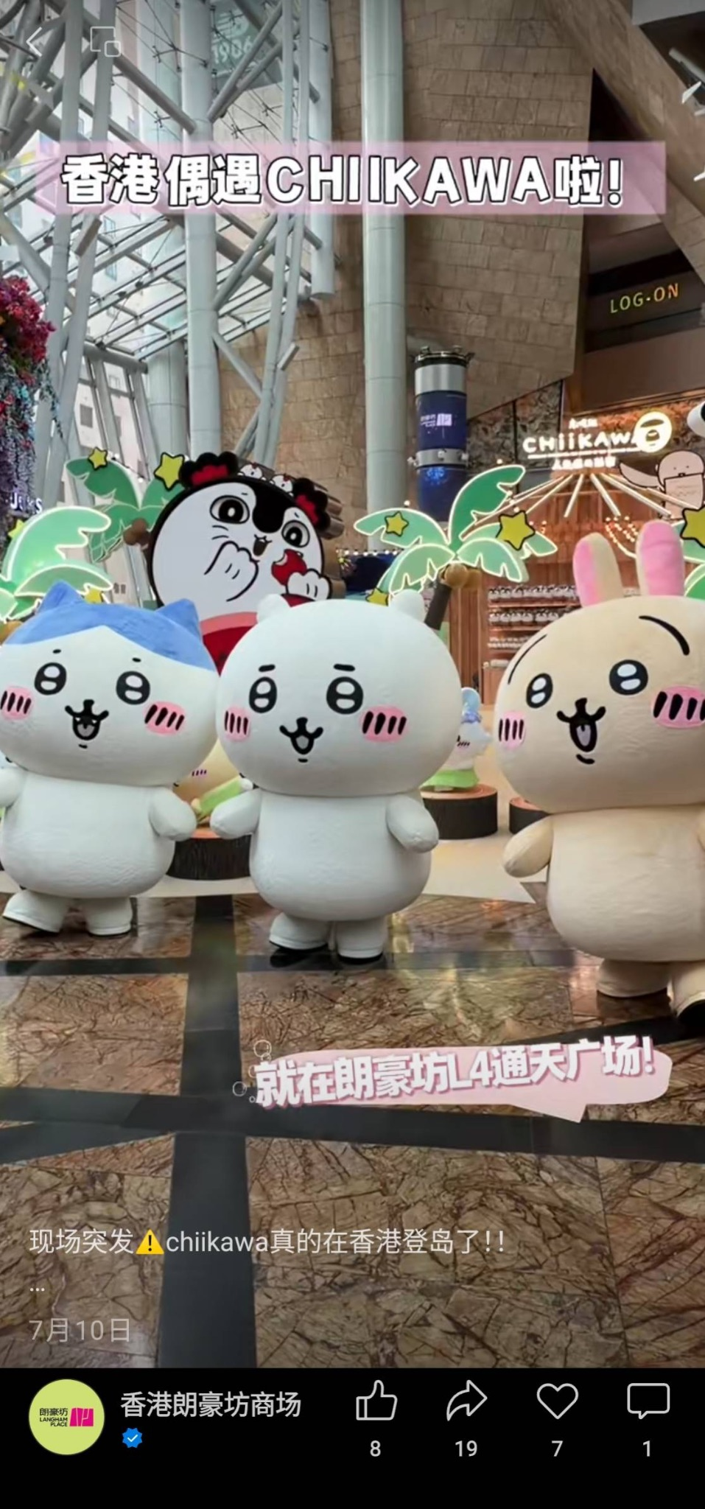
Channel Performance Summary
We released 5 videos on Channel in July. Chiikawa content performed best, with "現場突發chiikawa真的在香港登島了" recording the highest views and engagement, proving that IP teaser and event content drive the strongest performance on Channel. Cultural content "粵語文創" attracted decent views but lower engagement — adding more interactive prompts could encourage sharing and interaction.
Compared to June, views rose 9.3% (10,168→11,113), engagement rose 67.6% (34→57), and engagement rate improved from 0.33% to 0.51%. The growth was driven by the Chiikawa IP momentum, indicating that high-profile IP content significantly boosts Channel performance.
Post | Date | Subject | View | Recommend | Comment | Like | Share | Total Engagement | Engagement Rate
1 | Jul 4 | 香港速冲🔥Sanrio新系列可爱爆炸⚽️ | 2,244 | 1 | 0 | 7 | 0 | 8 | 0.36%
2 | Jul 7 | 确定了⚠️7月CHIIKAWA要在香港登岛啦！！ | 2,821 | 2 | 0 | 3 | 8 | 13 | 0.46%
3 | Jul 10 | 现场突发⚠️chiikawa真的在香港登岛了！！ | 3,190 | 6 | 0 | 7 | 16 | 29 | 0.91%
4 | Jul 16 | 香港粤语文创...我真的没空陪你闹了！😂 | 2,833 | 0 | 0 | 5 | 1 | 6 | 0.21%
5 | Jul 30 | 『香港避暑』旺角邂逅金庸的武侠世界 | 25 | 0 | 0 | 0 | 1 | 1 | 4.00%
Jul Total |  |  | 11,113 | 9 | 0 | 22 | 26 | 57 | 0.51%
*ENGAGEMENT = MARK + COMMENTS + LIKES + SHARES

Slide 10
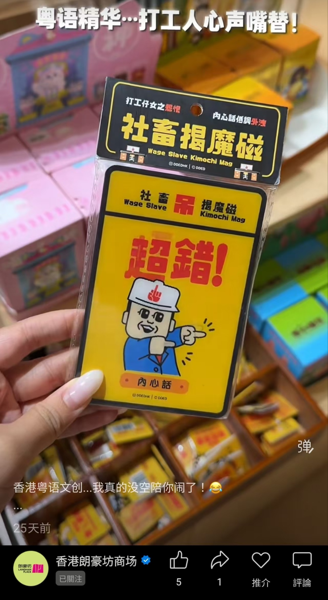
Channel Boosting Performance
In July, we boosted 5 videos for RMB 250, generating 10,172 views and 17 engagements. Boosting focused on IP content, with Chiikawa event launch video receiving two rounds of boosting to sustain campaign momentum. The top performer was "粵語文創" (2,684 views) , reflecting that local culture content resonates strongly with audiences.
Since May, top-view boosted content has consistently been local lifestyle and cultural content (街訪, 麵包腦袋, 飾品店), indicating strong audience receptivity toward relatable, topical local content. Going forward, we recommend prioritizing local lifestyle content with second or third boosts to extend reach, while using IP content for niche audience targeting.
Subject | Period | Objectives | Cost￥ | View | Likes | Recommend | Comment | Share | Follow | Engagement
香港速冲🔥Sanrio新系列可爱爆炸⚽️ | 07/10 | Impressions | ￥50 | 2,119 | 4 | 1 | 0 | 0 | 1 | 6
确定了⚠️7月CHIIKAWA要在香港登岛啦！！ | 07/10 | Impressions | ￥50 | 2,561 | 2 | 0 | 0 | 0 | 0 | 2
现场突发⚠️chiikawa真的在香港登岛了！！ | 07/10 | Impressions | ￥50 | 1,511 | 3 | 0 | 0 | 0 | 0 | 3
现场突发⚠️chiikawa真的在香港登岛了！！ | 07/13 | Impressions | ￥50 | 1,297 | 1 | 0 | 0 | 1 | 1 | 3
香港粤语文创...我真的没空陪你闹了！😂 | 07/21 | Impressions | ￥50 | 2,684 | 3 | 0 | 0 | 0 | 0 | 3
Jul Total |  |  | ￥250 | 10,172 | 13 | 1 | 0 | 1 | 2 | 17
*ENGAGEMENT = MARK + COMMENTS + LIKES + SHARES

Slide 11
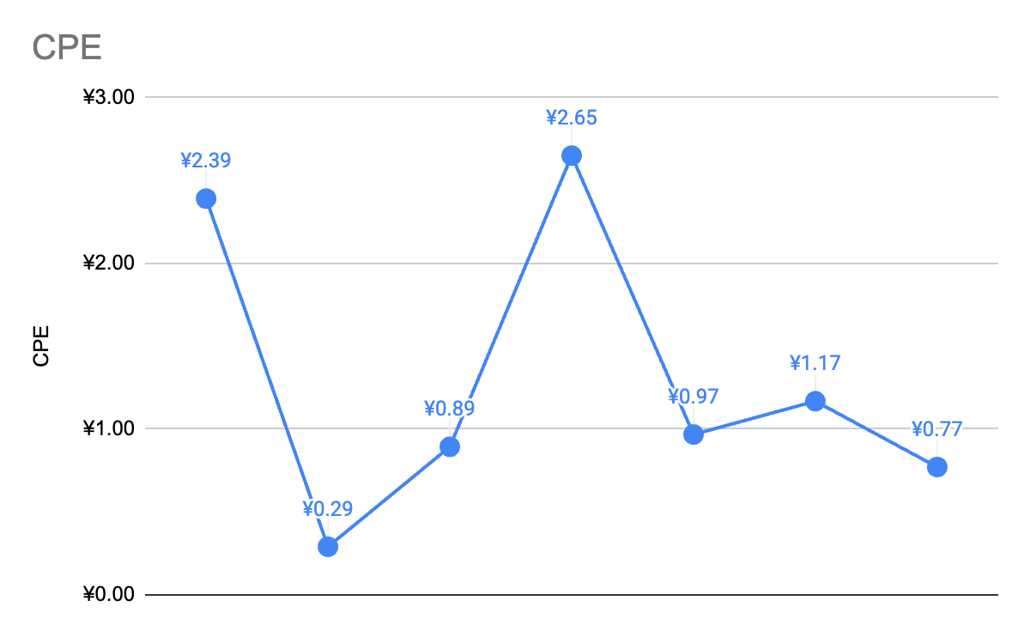
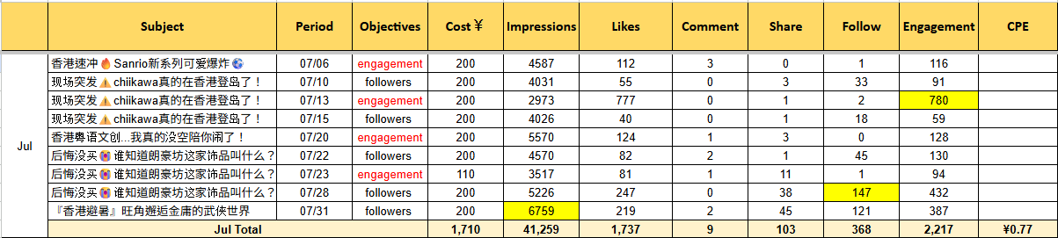
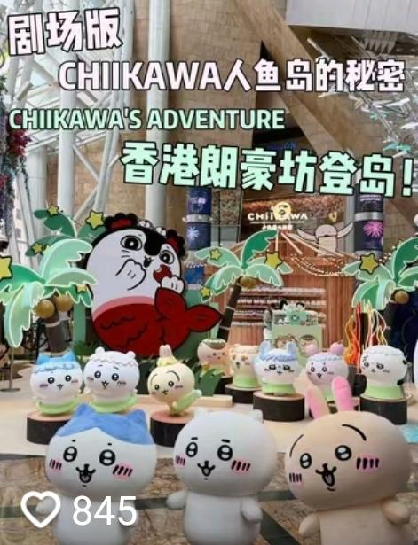
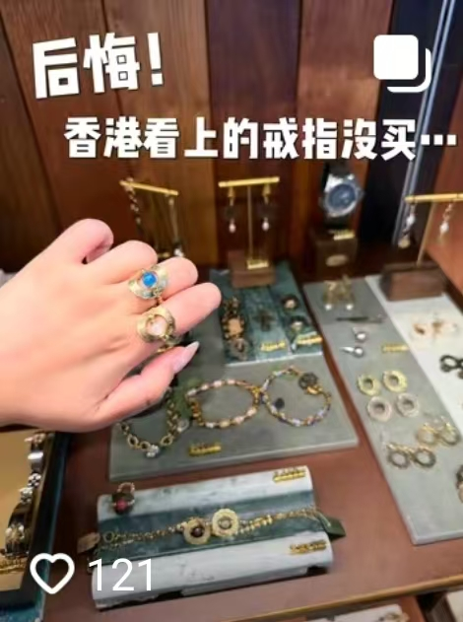
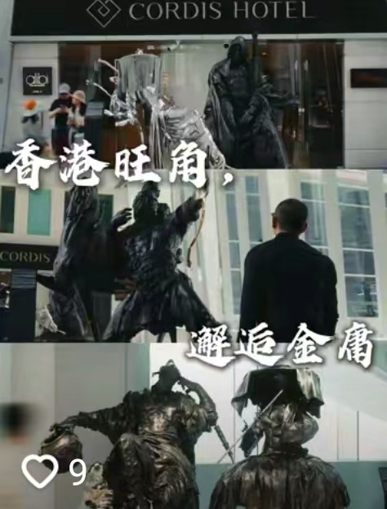
Douyin Performance Summary
In July, 5 videos were published. "粵語文創" performed best (911 engagements, 14.6K views).
Boosting highlights: Chiikawa video led in engagement, proving IP content drives interaction. 飾品店 post led in followers, while 金庸武俠世界 video led in impressions with followers second, showing cultural and lifestyle content delivers both reach and follower.
July overall CPE was ¥0.77, lower than May, June and the 2025 benchmark, also the lowest since January (except February), demonstrating that the "engagement + followers" hybrid strategy since May continues to improve cost efficiency.
2025 Benchmark ¥0.65
Jan
Feb
Mar
Apr
May
Jun
Jul
Overall Performance |  | View | Like | Comment | Share | Saved | Total Engagement | Total Engagement Rate
 |  | 39,083 | 1,726 | 10 | 69 | 414 | 2,219 | 5.68%
Boosting Performance | Cost | Impressions | Like | Comment | Share | Follow | Total Engagement | CPE (Cost Per Engagement)
 | ￥1,710 | 41,259 | 1737 | 9 | 103 | 368 | 2,217 | ￥0.77

Slide 12
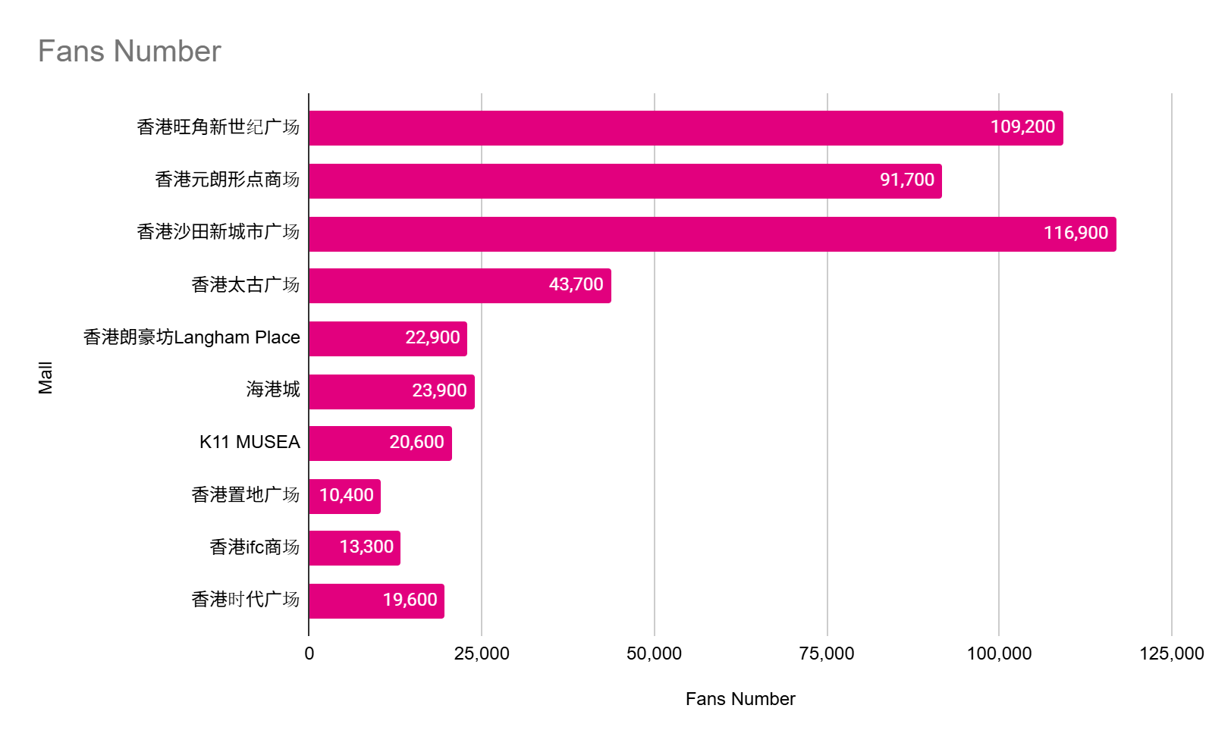
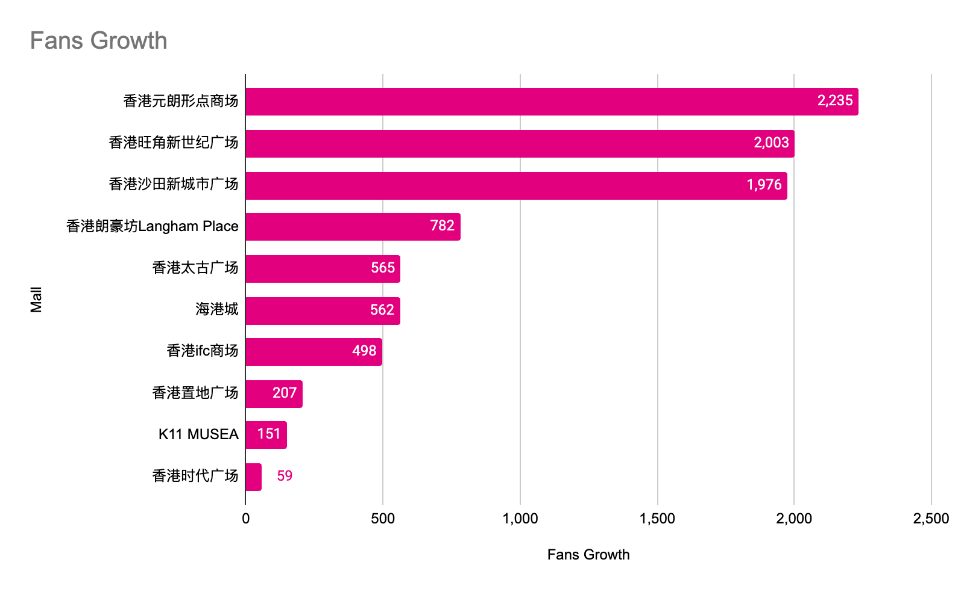
Competitors Analysis- Fan Base
By the end of July 2026, Langham Place ranked No.5 among Hong Kong shopping malls in total follower count and No.4 in monthly new follower growth, both up one position from June.
Source: https://www.huitun.com/
Data range: 2026.7.1 - 7.31

Slide 13
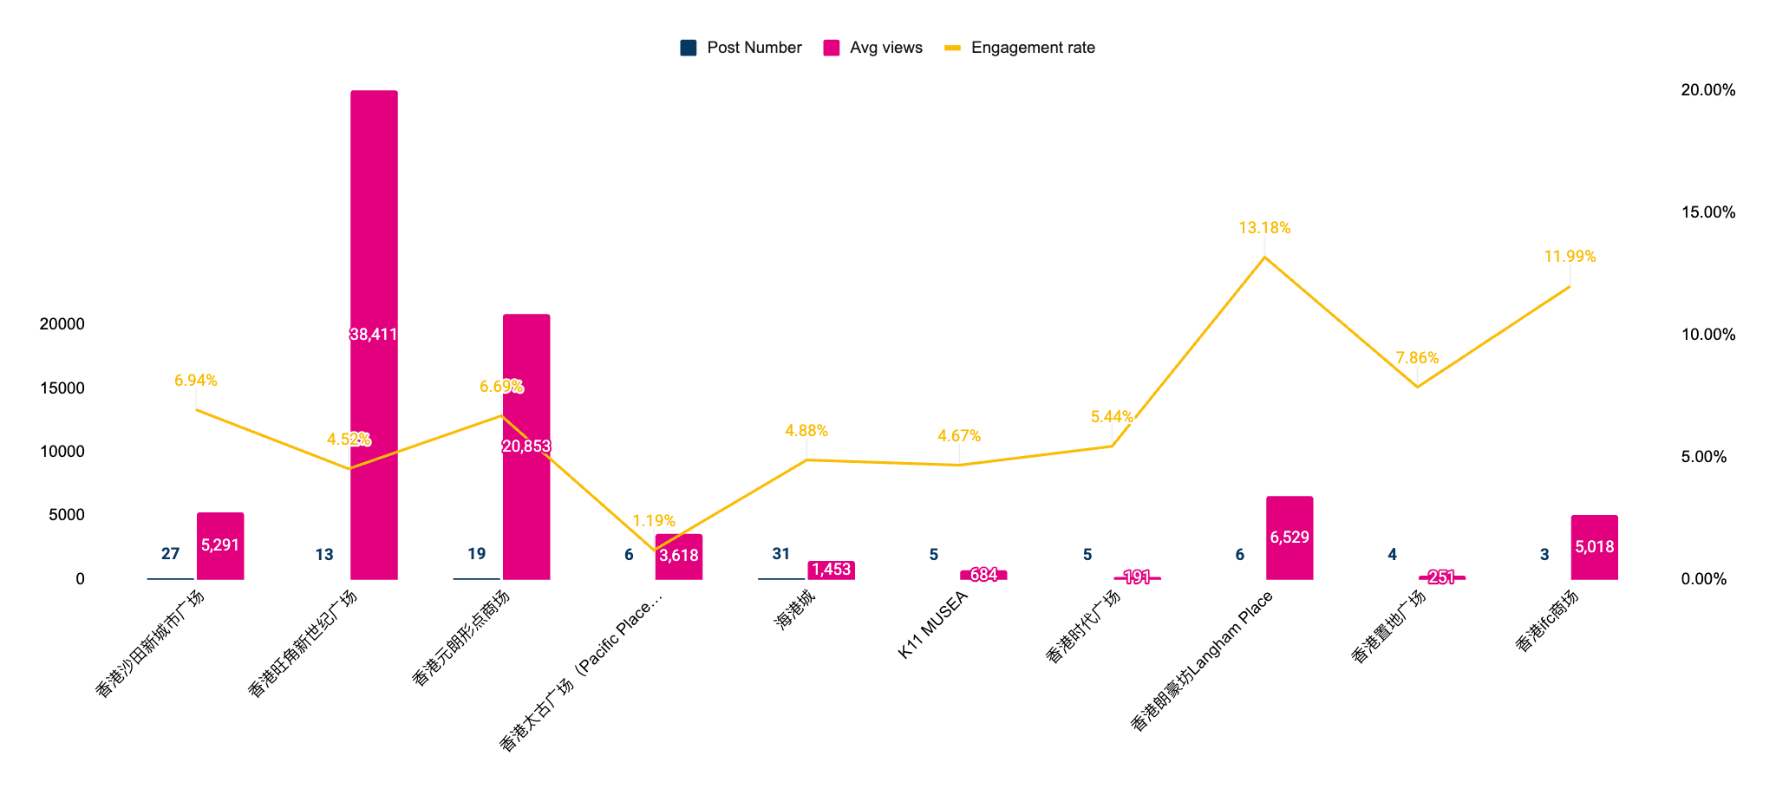
Competitors Analysis- Brand Account Content
In July, Harbour City led in post volume with 31 posts, followed by New Town Plaza (27) and YOHO (19).
MOKO recorded the highest average views (38,411), followed by YOHO (20,853).
Langham Place ranked third in average views and first in engagement rate (13.18%), significantly outperforming competitors with higher post frequency. This reflects that our "quality over quantity" strategy effectively drives interaction and resonates with audience.
Source: https://www.huitun.com/
Data range: 2026.7.1 - 7.31

Slide 14
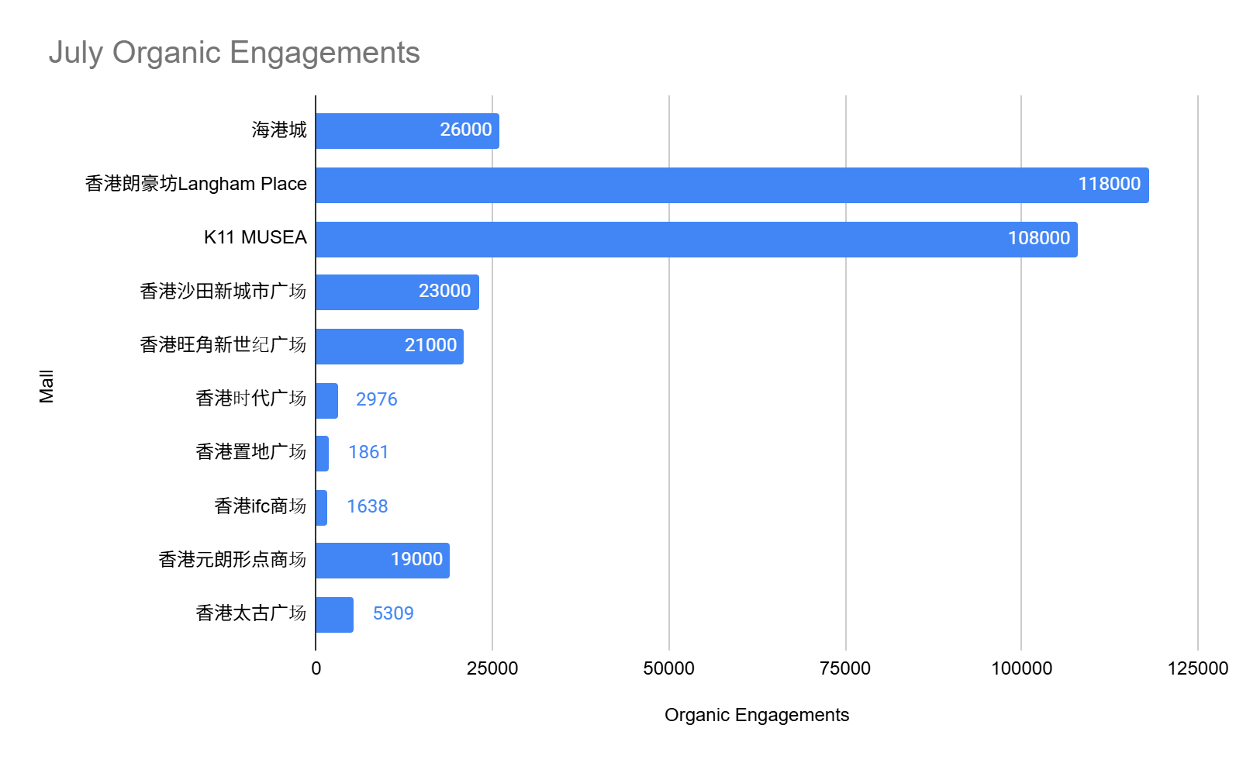
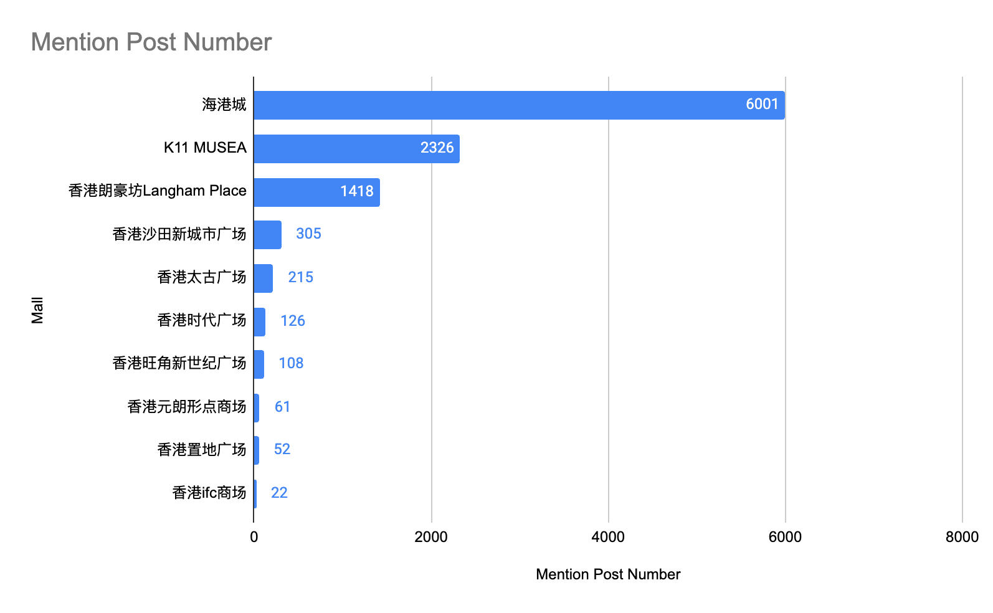
Competitor Organic Traffic Analysis - UGC
In July, there were 1,418 posts mentioning Langham Place, generating 118K organic engagements. Compared to June, post volume more than doubled (+105%, 690→1,418) and engagements rose 16.8% (101K→118K), driven by the Sanrio and Chiikawa IP buzz.
Among competitors, Harbour City led with 6,001mention posts. Langham Place ranked third in mention post volume yet secured second place in organic engagements, continuing to outperform its mention‑post ranking.
Data range: 2026.7.1 - 7.31
Source: https://www.huitun.com/

Slide 15

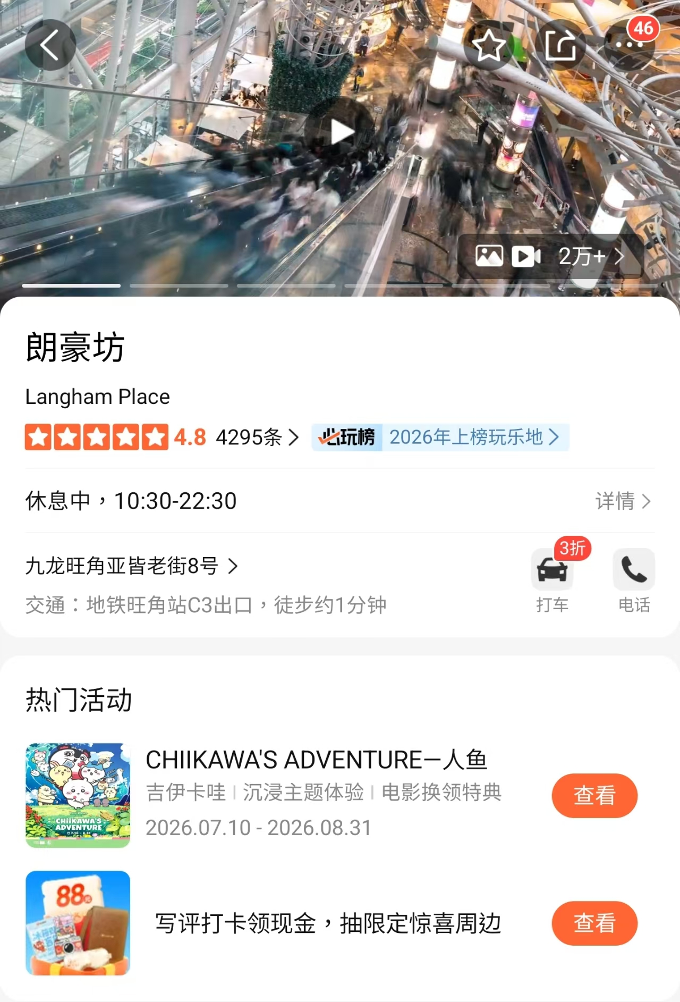
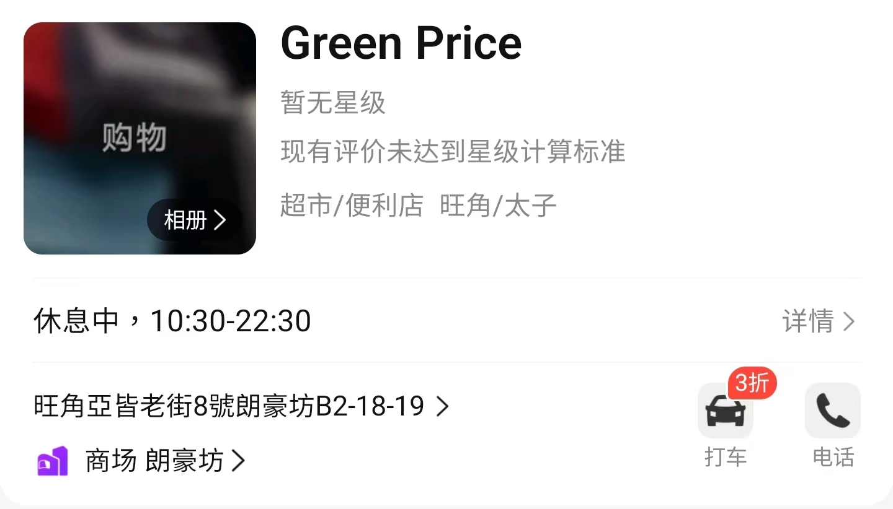
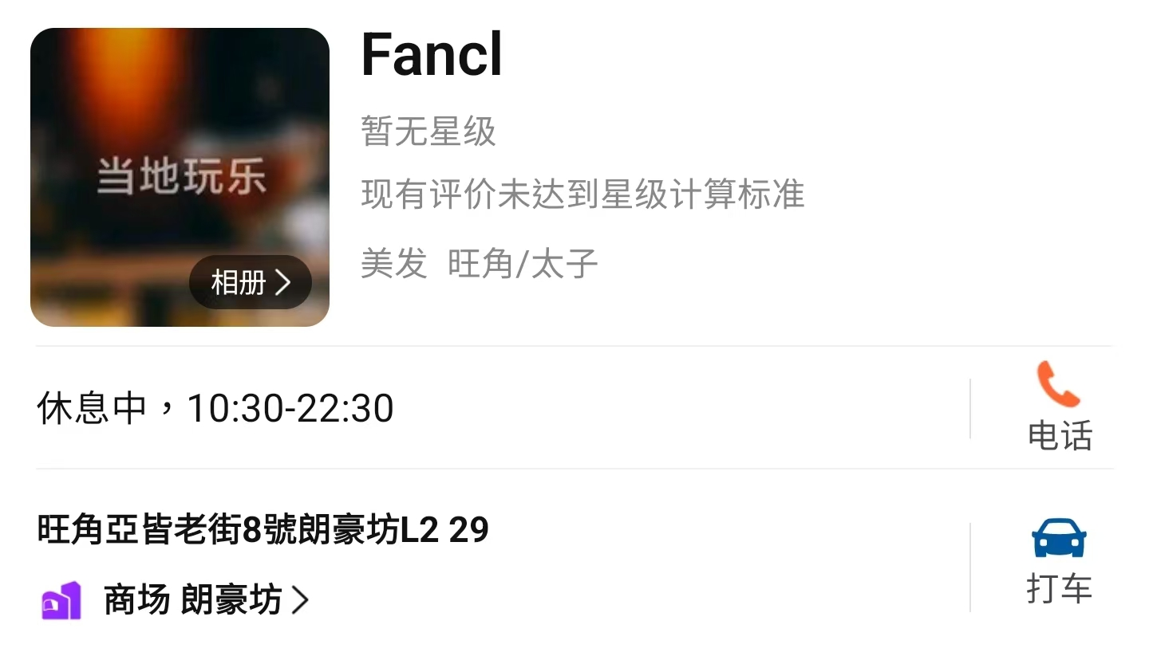
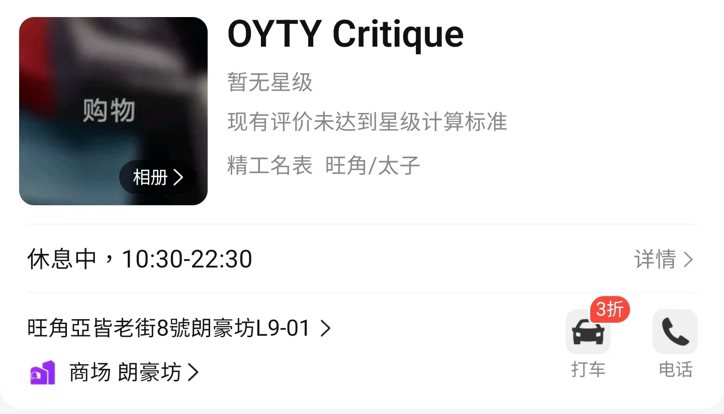
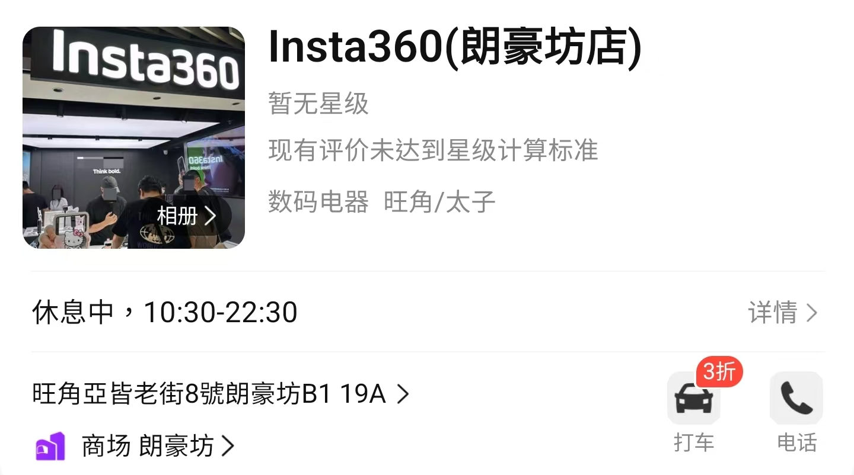
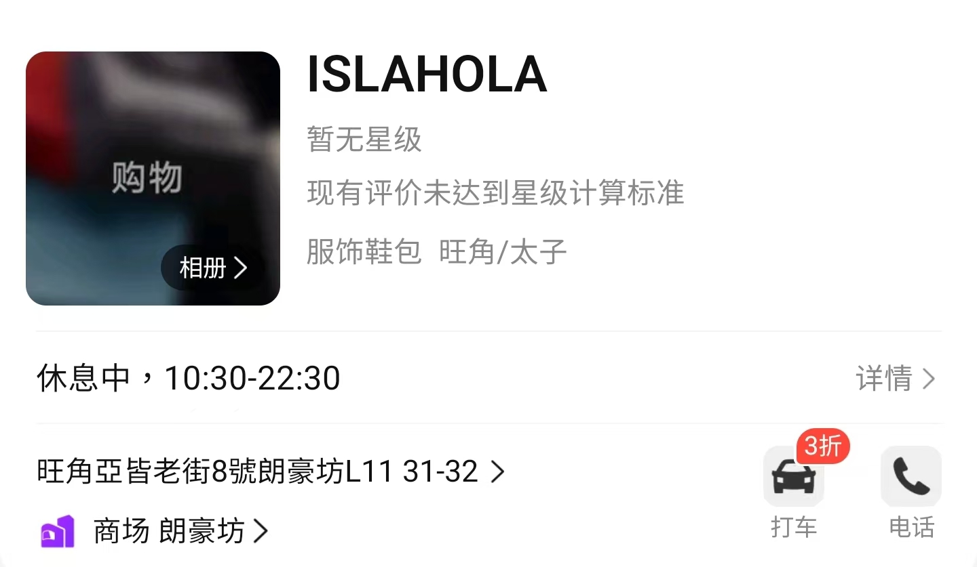
Dianping July Report
In July, Dianping recorded 52,775 impressions, 14,643 visits, and 4,593 interested users, all hitting new highs for the year. Growth was driven by IP campaigns, along with new activity listings that attracted mainland tourists to discover the latest event updates, boosting all metrics.
In July, 5 new tenants were added to Langham Place, while 5 tenants were closed.
Sanrio and Chiikawa were added to the platform's featured activities section.
Dianping Performance
Month | Impression | Visits | Interested Users
July | 52,775 | 14,643 | 4,593
June | 41,362 | 10,868 | 3,385
May | 45,752 | 11,686 | 3,362
April | 40,504 | 9,778 | 2,851
March | 33,380 | 9,150 | 2,737

Slide 16
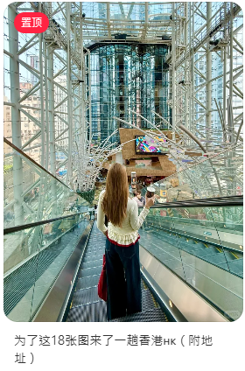
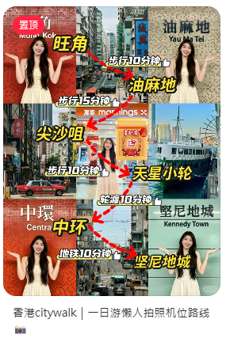
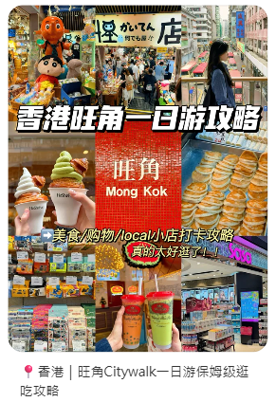
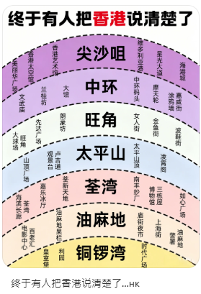
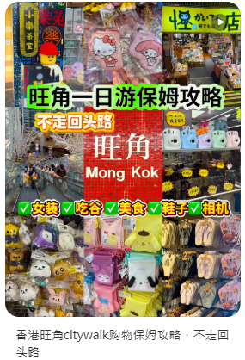
Organic Traffic Analysis- Top 5 Posts
In July, Langham Place was frequently mentioned in organic Xiaohongshu posts on "Mong Kok Citywalk," "one-day guides," and "photo spots."
Unlike June's visual-focused content, top posts now offered more practical, all-in-one itineraries, reflecting users' preference for time-saving travel planning. Langham Place emerged as a "must-visit" stop in Mong Kok, reaffirming its status as a district landmark.
The shift from single-day routes to broader Hong Kong guides also signals growing demand for deeper travel content.

Slide 17



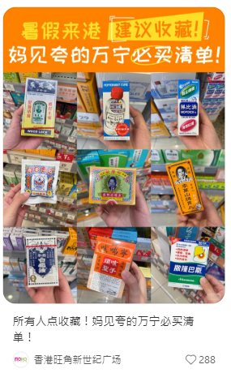
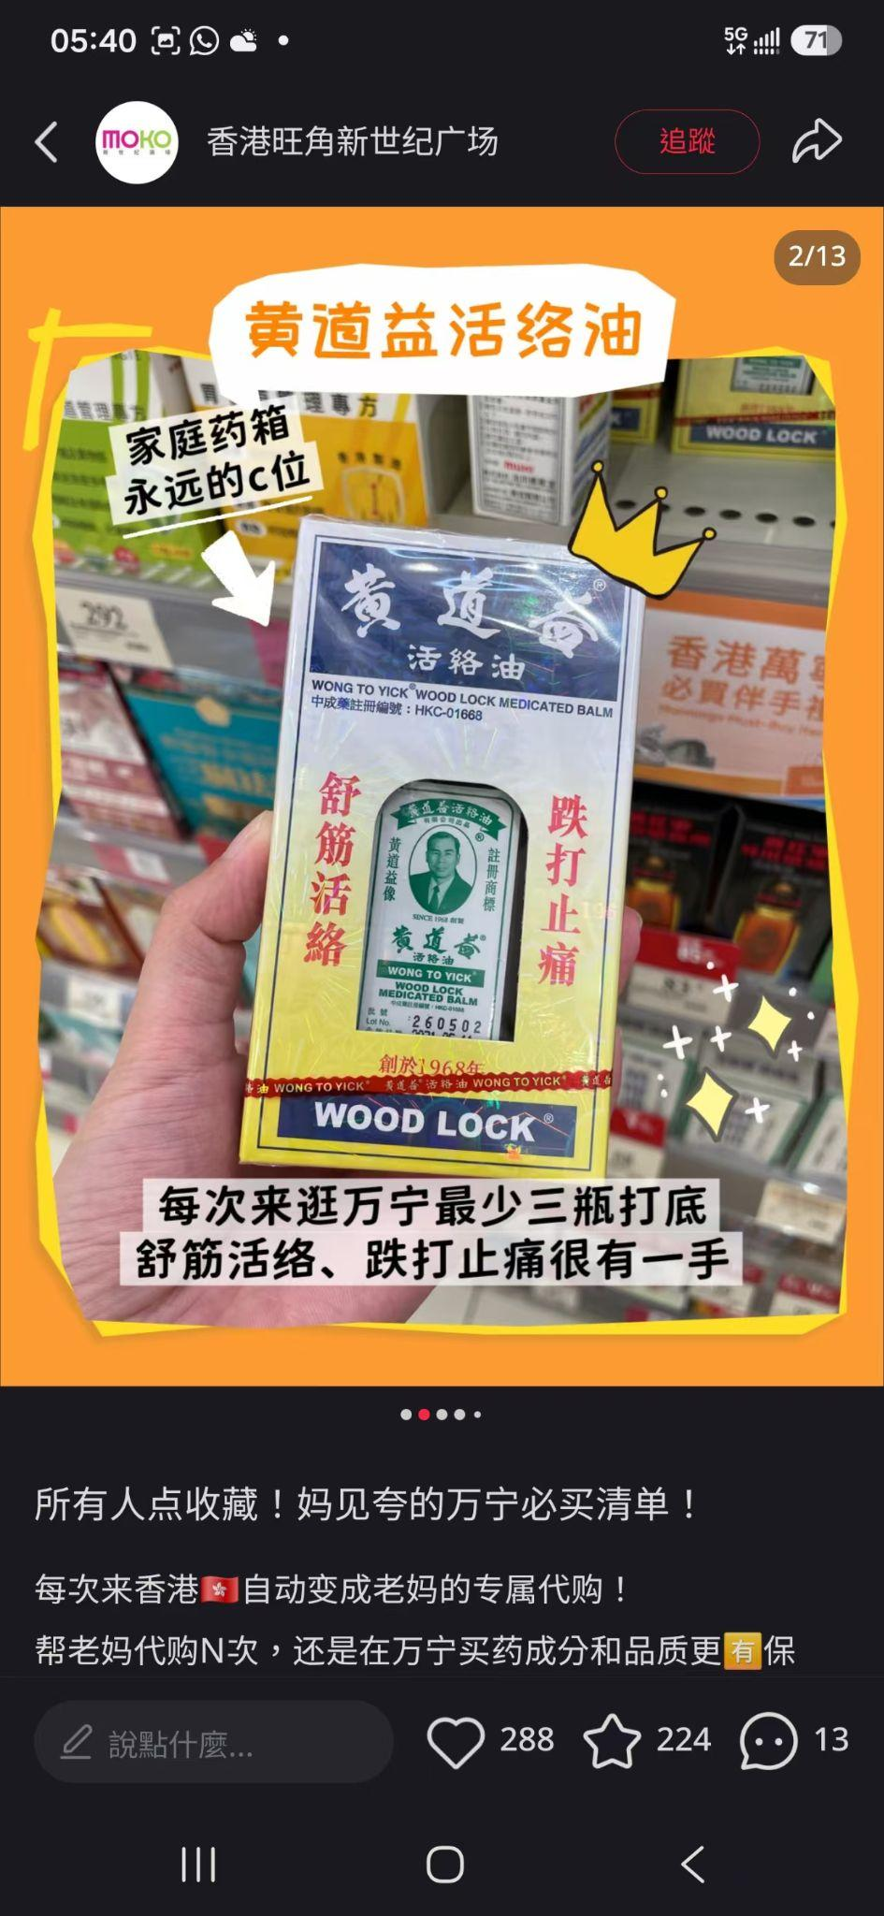
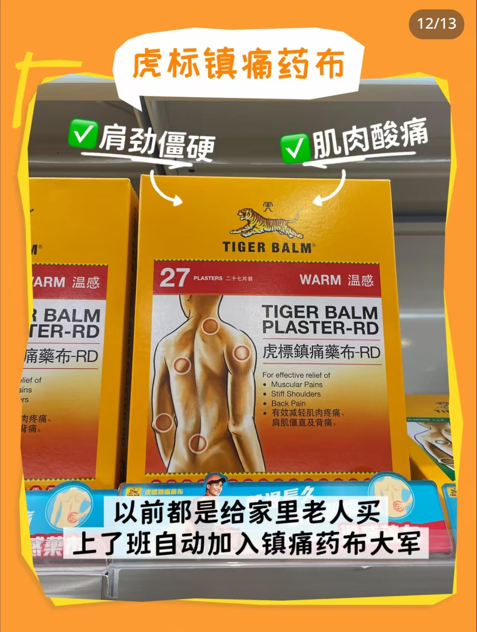
Competitors Analysis - XHS
New Town Plaza
MOKO
Total posted 13 article feeds in July.
Content pillars: IP Event, Shopping Guide, Fashion, Beauty, Giveaway
Post analysis-所有人点收藏！妈见夸的万宁必买清单！
Positioned MOKO as HK's pharmacy souvenir hub with
a "mom-approved" hook targeting young gift-buyers
Drove high saves and long-tail traffic with a practical checklist, proving emotional resonance boosts engagement
22 articles and 5 videos feeds in July, total posted 27 feeds.
Content Pillar：IP Event, Shopping Guide, Travel , Beauty, F&B, Giveway
Post analysis- 报意思！7.29国际唇膏日，沙田要搞大事💋
Curated 6 beauty brands under a "celebrity same-style" theme for International Lipstick Day. Turned a niche occasion into a buzzworthy event with star power and limited-time offers
Drove engagement and foot traffic while reinforcing New Town Plaza's beauty destination positioning

Slide 18
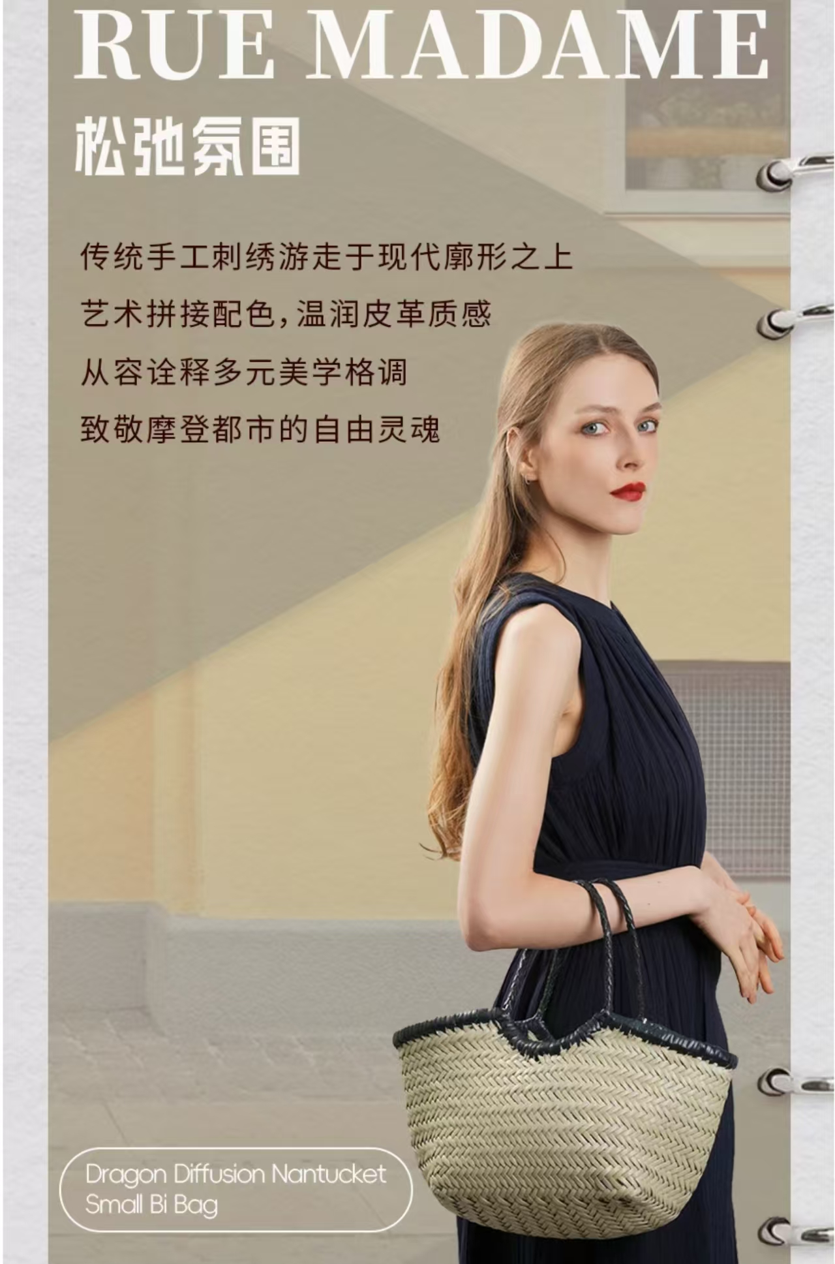

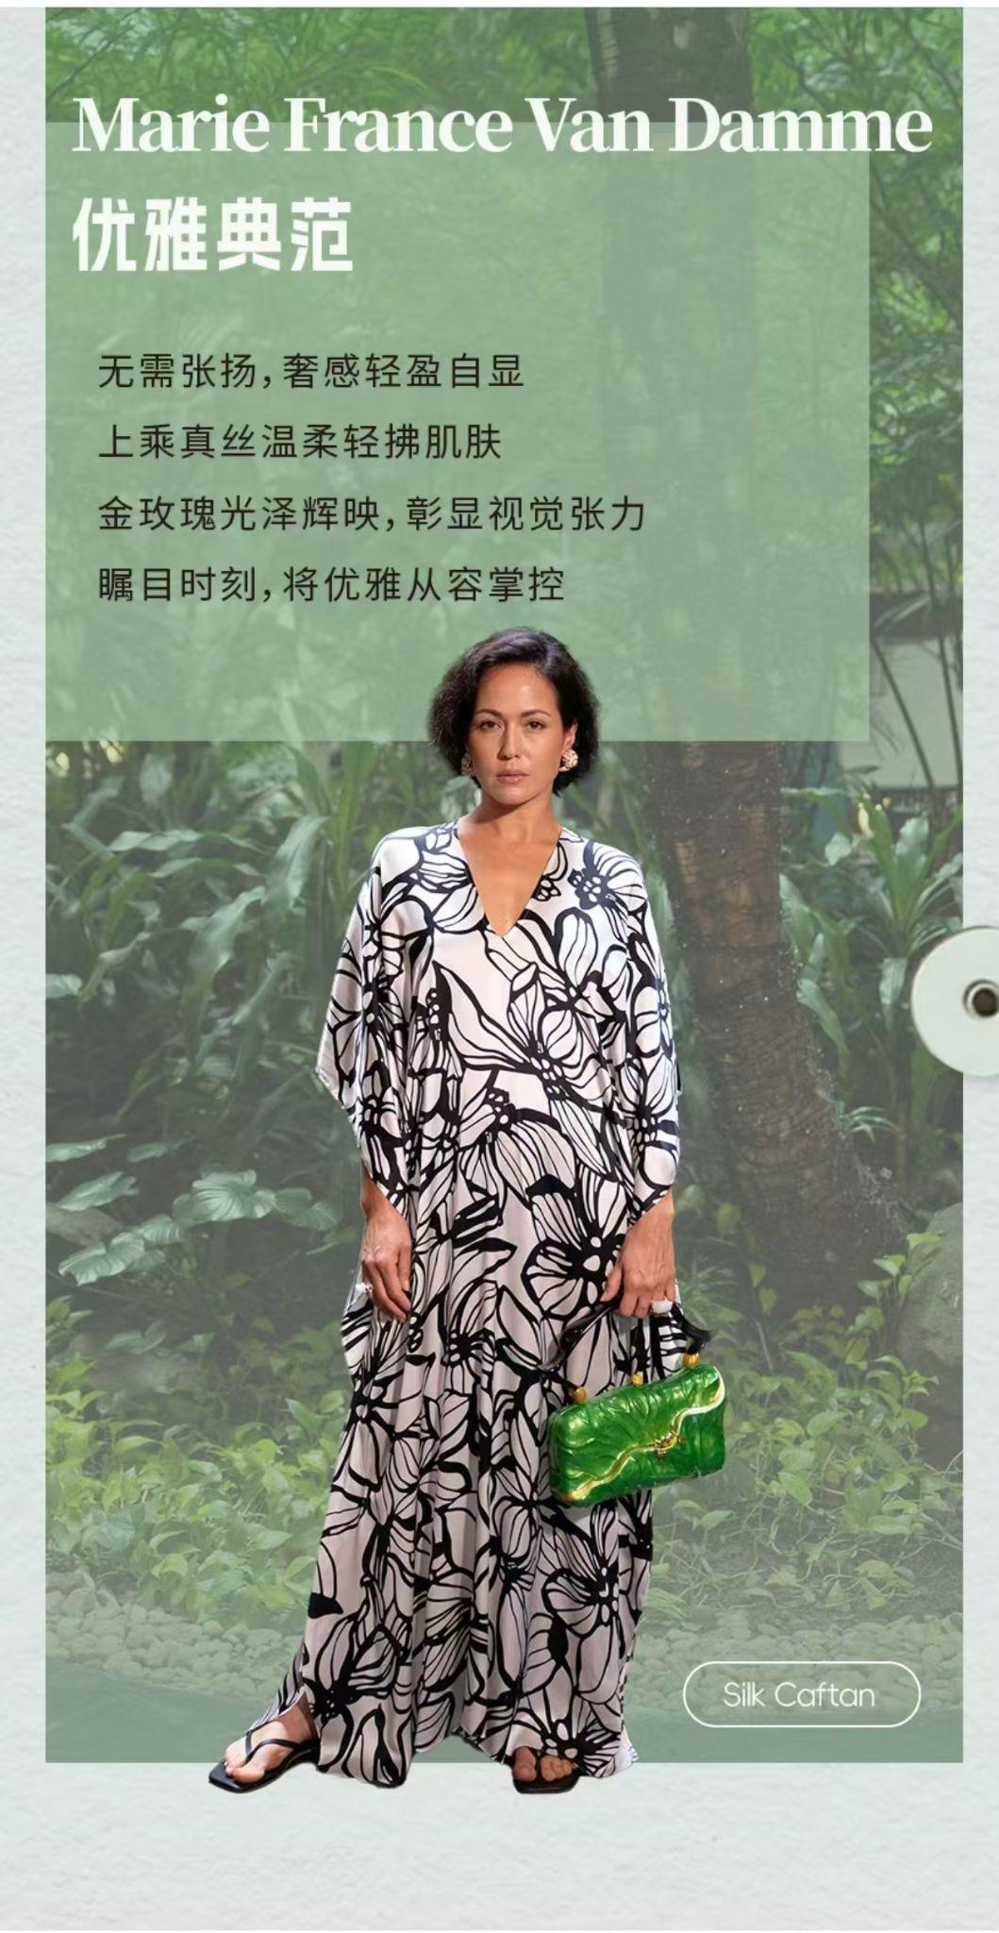
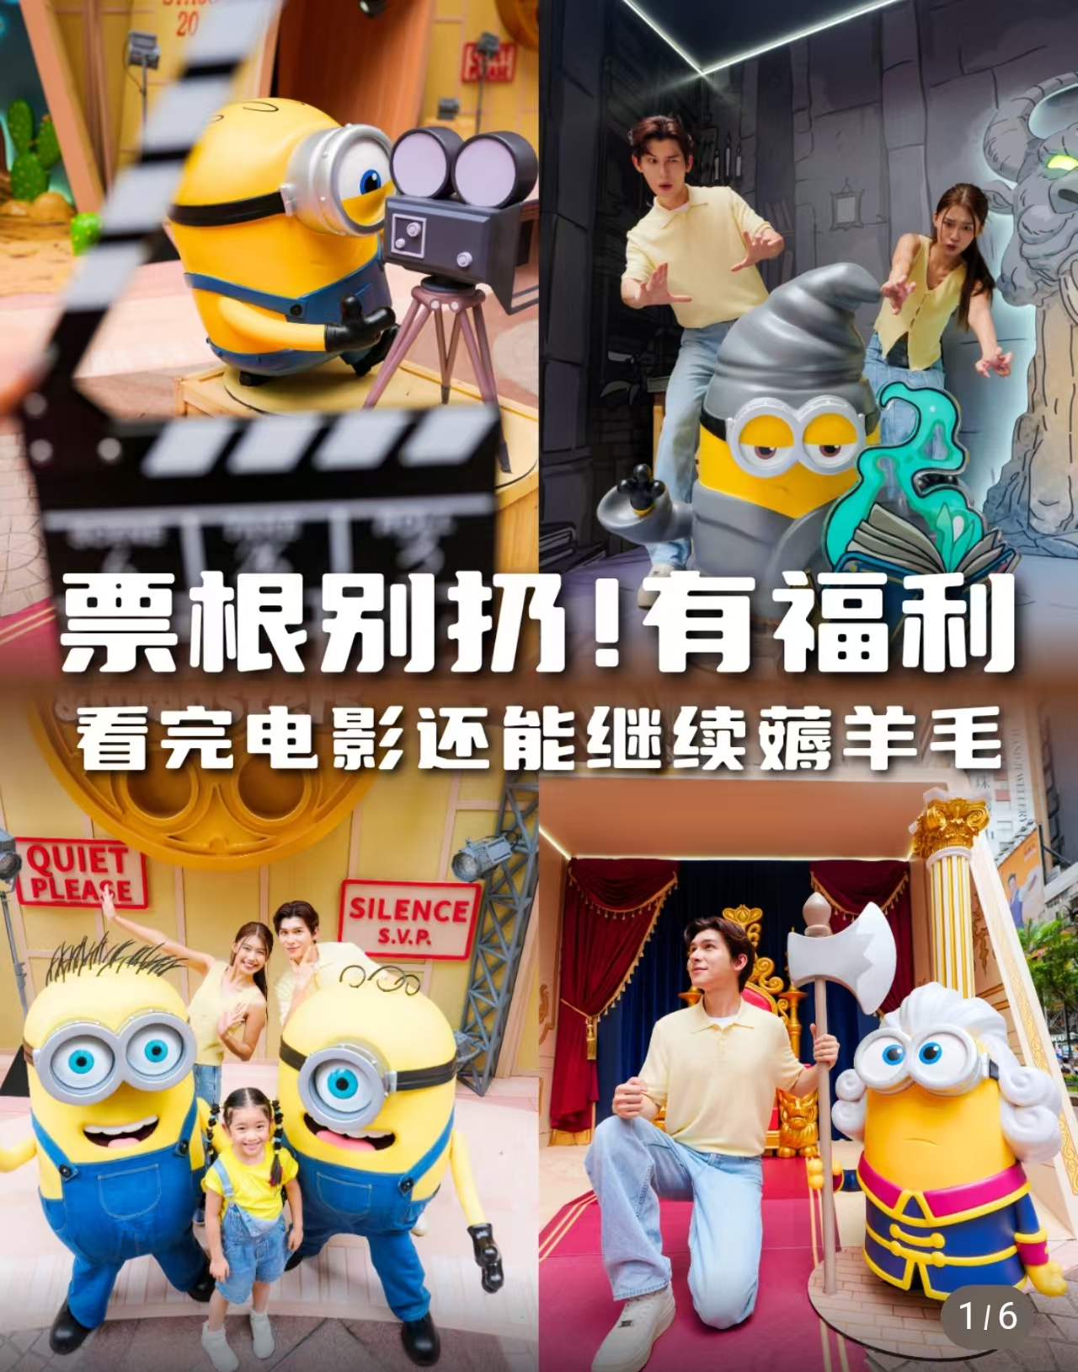

Competitors Analysis - WeChat
Times Square
IFC
Pattern: 4 articles in July with over 2.85K views
Content pillars: IP Events, F&B, Fashion, Lifestyle
Post analysis- 本命穿搭｜先有性格，再有风格
Used "personal style" as the thematic hook with trending keyword "本命" in the headline
Curated 4 brands across different aesthetics and presented them as a style guide rather than a product push
Positioned ifc as a destination for fashion and self-expression, appealing to shoppers who value taste over trends
Pattern: 4 articles in July with total over 2.3K views.
Content pillars: Festive, IP Event, Shopping Guide
Post analysis-🍌小黄人拍了拍@你！来香港凭票根领福利！
Leveraged "movie ticket as VIP pass" concept, turning a disposable item into a mall-wide通行證
Unlocked exclusive offers across 10+ F&B and retail tenants
Paired with Minions IP and interactive tasks to create a playful scavenger hunt experience
Drove cross-category spending and extended dwell time

Slide 19






Competitors Analysis - Channel
AIRSIDE: 9 x Videos
Content pillars: IP Event, Shopping Guide, F&B
YOHO : 3 x Videos
Content pillars: Travel Guide, F&B, Lifestyle
Used "summer heat" and "ice cream cravings" to curate 7 dessert spots, positioning AIRSIDE as a one-stop dessert destination
Turned a sweet treat into a food-hopping 种草 experience, attracting families, couples, and young shoppers
Transformed an in-mall Sanrio IP event into a "Yuen Long travel guide" with 7 check-in installations
Combined location-based storytelling, photo guidance, and spend-and-redeem rewards to shorten the path from discovery to in-store dining, driving foot traffic and F&B

Slide 20




Competitors Analysis - Douyin
New Town Plaza: 4 x Videos
K11 MUSEA: 2 x Videos
This video urned the mall into an 80s/90s Hong Kong playground with retro sets, snacks, games, and Cantopop parties
Evoked childhood memories to drive engagement with local families, millennials, and young shoppers
This video positioned K11 MUSEA as an art destination through L'ÉCOLE jewellery exhibition, not retail
Made high-end art accessible via workshops, masterclasses, and a scavenger hunt, captivating art lovers, families, and culturally curious travellers

Slide 21


Insights & Suggestions
1. 生活提案式種草—旺角人的生活
Core Concept:
XHS content thrives on resonance, not persuasion — lifestyle content drives strong organic reach, as shown in previous data. Using a "day in my life" framework invites users to imagine themselves at Mong Kok and get naturally "种草" without hard-selling.
「跟著街坊逛旺角! 朗豪坊本地人认证清單」
Exploring Langham Place like a local — a curated list of "neighborhood-approved" stores and eats around the mall that only insiders know.
「旺角人的週末療癒清單」
A local's weekend healing list — the best quiet corners at Langham Place for a coffee break, a good book, or a peaceful meal away from the city rush.
「下班去哪兒？旺角人夜晚鬆弛指南」
After-work escape plan — how locals unwind in Mong Kok after dark, from a quiet drink to a solo movie night at Langham Place.

Slide 22


Insights & Suggestions
2. 特種兵式旅遊 – High-Value Check-in Guide
Core Concept:
特種兵式旅遊 continues to trend among young tourists, with topics like "Citywalk" and "one-day tours" gaining strong traction on XHS. Langham Place can position itself as a key stop on budget-friendly routes, photo spots, affordable dining, and great-value shopping — all tailored to young travelers seeking efficient, low-cost itineraries.
「旺角高CP值路線! 打卡兼掃貨」
A high-value Mong Kok route combining photo-worthy spots and great shopping finds — starting from Langham Place.
「本地人帶路！香港橫街窄巷美食攻略」
Let a local guide you through Hong Kong's backstreets — uncovering the best bites within a stone's throw of Langham Place.
「香港人私心推薦！來港必買清單」
Hong Kong locals' personal favorites — the must-buy shopping list at Langham Place.

Slide 23





Insights & Suggestions
3. 大學開學OOTS — Back-to-School Fashion
Core Concept:
Back-to-school season drives OOTD content demand on XHS. Langham Place can position itself as the go-to destination for students, combining practical style guides with Mong Kok street style. Using trending hashtags like #OOTS and #开学 can boost content reach with algorithmic traffic support.
「OOTS 港校開學穿搭！本命開學造型GET」
A back-to-school style—mix and match in-mall brands to find your "本命" (perfect match) look for the new semester.
「新生入學變身計劃！大學第一印象這樣穿」
Back-to-school style rescue kit for freshmen—different looks for different student personas, from artsy to sporty to Hong Kong cool.
「留學生落地香港第一站！朗豪坊開學置裝清單」
The ultimate back-to-school shopping list for incoming mainland students—everything you need for HK's climate, all at Langham Place.

Slide 24
KOL Campaign status
In chiikawa campaign, we invited 1x KOLs , 5 x KOCs and 10 x Seedings to create total of 28 posts.
Until now, KOL campaign gained 123K+ views, 9.7k+ engagements and 7.89% engagement rate.
Total No.of KOL: 1
Total No.of Posts:
15 photos
13 Videos
Total Views:
123,217
Total Engagement:
9,726
Engagement Rate: 7.89%
Data collected by Aug 3

Slide 25


KOL Campaign Summary
Among all campaigns, the chiikawa campaign delivered average views at a mid-tier level.
With only 1 quota, it achieved a 7.89% engagement rate, showing strong conversion efficiency for the brand activation.
Data collected by Aug 3

Slide 26


KOL Performance
KOL “喵星人汪一个” published two Chiikawa-themed short videos promoting Langham Place. The posts accumulated 14,858 views and 1,461 total engagements, with an overall engagement rate of 9.83%.
The second video outperformed the first across all interaction metrics, demonstrating strong audience appeal of the Chiikawa IP content.
KOL name | Fans No | Post feed | Post link | Views | Likes | Saves | Comments | Total Engagement | Engagement rate
喵星人汪一个 | 114,000 | Video | link | 2,950 | 244 | 24 | 20 | 288 | 9.76%
喵星人汪一个 | 114,000 | Video | link | 11,908 | 806 | 332 | 35 | 1,173 | 9.85%
Total |  |  |  | 14,858 | 1,050 | 356 | 55 | 1,461 | 9.83%
Data collected by Aug 3

Slide 27


KOC Performance
5 KOCs generated 33,712 views and 3,249 engagements.
(average 4.8K views and 464 engagements/KOC)
To maximise reach for the Chiikawa campaign, we selected creators with proven traffic performance who specialise in pop-up event check-ins, lifestyle and fashion content.
This campaign also tried XHS 報備 KOL post with 奶酪积垢.
Despite running without ad boosting, the organic performance was solid, proving the potential of this approach. We recommend further testing with high-potential KOLs in the coming months.
KOL name | Fans No | Post feed | Post link | Views | Likes | Saves | Comments | Total Engagement | Engagement rate
奶酪积垢 | 23,000 | photo | link | 17,713 | 1,345 | 271 | 38 | 1,654 | 9.34%
大旧忽 | 22,000 | photo | link | 2,079 | 147 | 24 | 8 | 179 | 8.61%
大旧忽 | 22,000 | photo | link | 1,227 | 136 | 55 | 4 | 195 | 15.89%
张张Zz💎 | 18,000 | photo | link | 2,339 | 173 | 126 | 37 | 336 | 14.37%
张张Zz💎 | 18,000 | photo | link | 3,613 | 265 | 108 | 27 | 400 | 11.07%
潘潘kiwi | 11,000 | photo | link | 4,245 | 212 | 113 | 21 | 346 | 8.15%
奶牛小钟 | 9,256 | video | link | 2,496 | 114 | 14 | 11 | 139 | 5.57%
Total |  |  |  | 33,712 | 2,392 | 711 | 146 | 3,249 | 9.64%
Data collected by Aug 3

Slide 28



Seeding Performance
19 Seedings generated 74,710 views and 5,016 engagements. (average 3.9K views and 264 engagements/Seeding)
Views & Engagement: KOL 小馬達阿豆 delivered the highest article views and the highest total engagement on video posts.
Engagement Rate: 愛旅行的 lulu achieved the highest engagement rate. Video content significantly outperformed photo posts, indicating stronger follower loyalty and greater potential for short-video collaborations.
Data collected by Aug 3

Slide 29


Learnings & Insights
Chiikawa Campaign Phase 2 (Aug): continue to emphasize the “chiikawa 痛城/痛楼” concept, positioning Langham Place as a key Chiikawa IP destination to drive moviegoers to Gala Cinema for the Chiikawa film.
Mid/Late Aug : Invite family-oriented and arts-focused KOLs to collaborate on phase3, promoting the 金庸 art sculptures and wrapping up the chiikawa event, while building anticipation for the two major holidays（中秋&黄金周） in Sep and Oct.
Promote the Cordis Hotel and transportation options for travelers coming to hk from the mainland, to attract more families traveling with children.

Slide 30
Thank You
Contact: info@dichat.hk

